Slide 1
CTA Service Menu
Administration CTA Online Portal©
Trade Allocations Access to Total CTA Positions
Daily Account Reconciliation Access to Indiv Account Positions
Equity and Margin Updating Access to Total CTA Margin/Equity
Real-Time Position Updating Access to Indiv Account Margin/Equity
Customizable Report Formats Account Performance- Daily, MTD, YTD
Brokerage New Accounts
Electronic Trading Platforms Oversee all new account forms
Direct Pit Execution Access Complete Client Customer service
Rating Site Updates

Slide 2
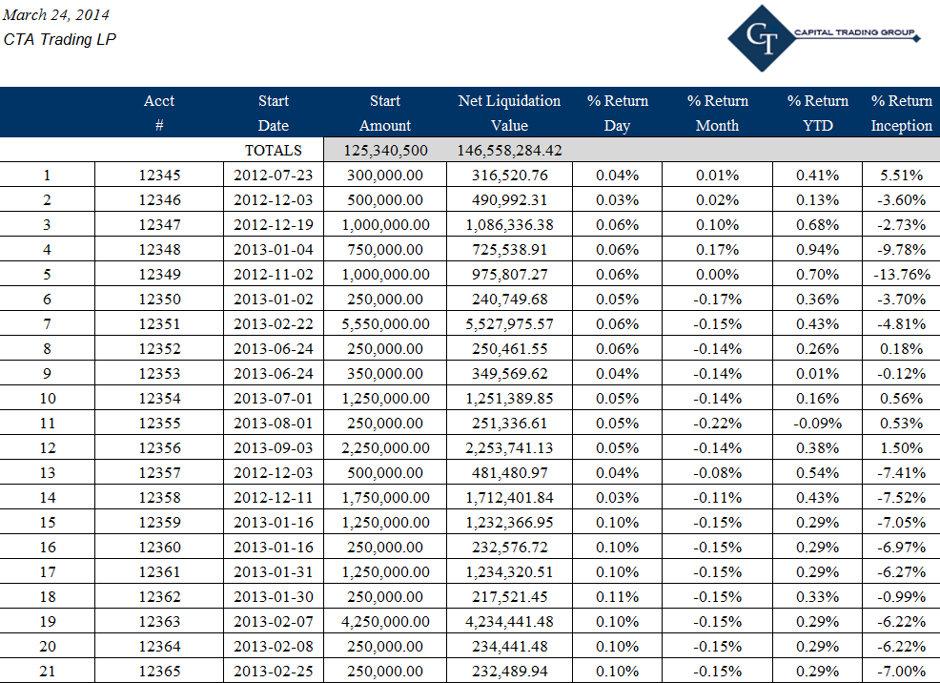
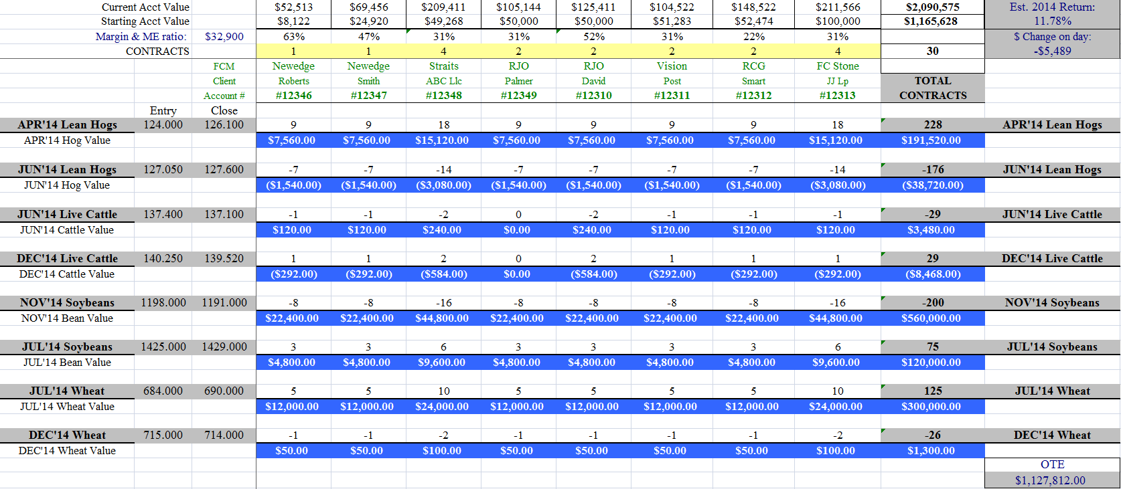
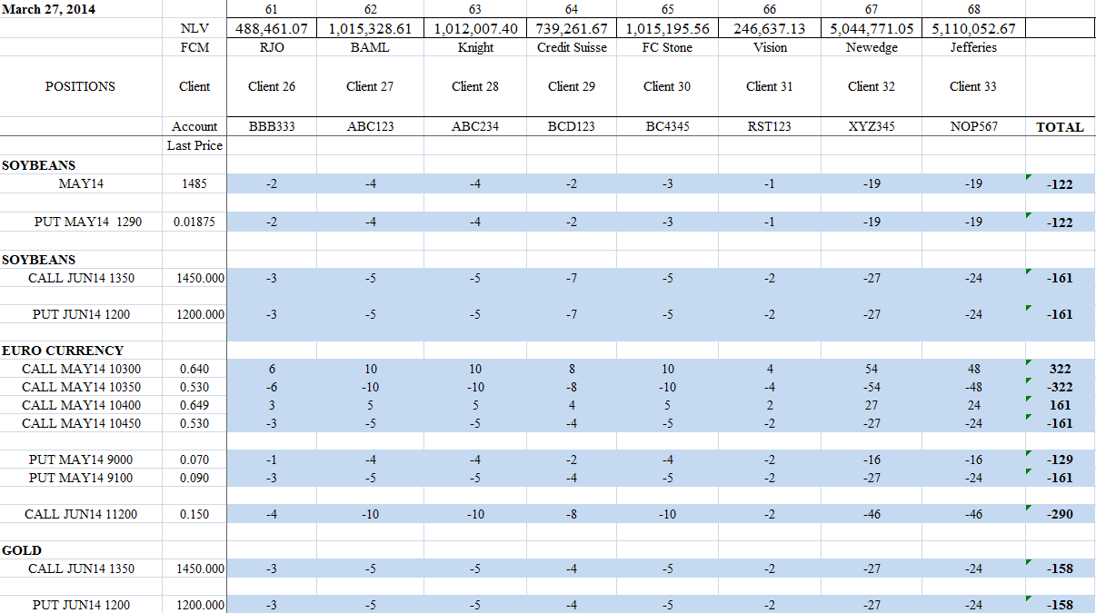
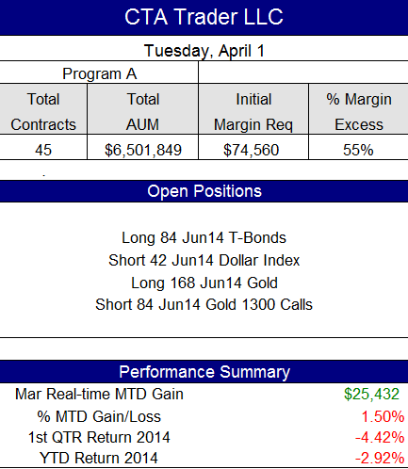
Our Customized Position Reports can be configured to your preference… And in Real-Time!
Our professional services are designed to make every aspect of your CTA business as efficient as possible. Our operations will be configured to help make your life easier so you can focus on what you do best: Trade.
CTG will oversee allocations – We’ll help you set up your electronic or pit execution, and establish a single block trading account that will enable NFA required APS pricing across all FCMs. We’ll make every one of your accounts, across any and all FCMs, receive their respective trades. Every day we reconcile each client account for accuracy: positions, equity, margin, fees, etc.
CTG customizes Position and Equity reports to just how you, the CTA, want to see them. We include the information that you want to see every day. Our position reports are updated in real-time throughout the trading day, so you always know exactly what positions you have one overall, and in each respective account.

Slide 3
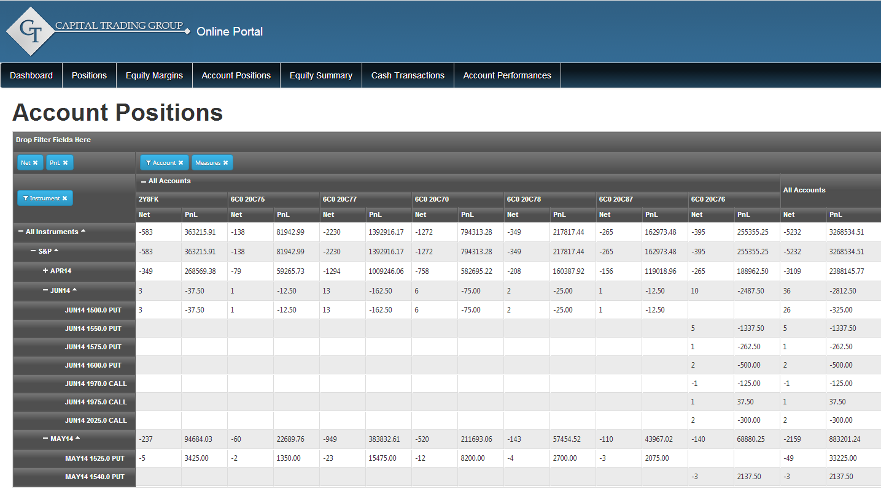
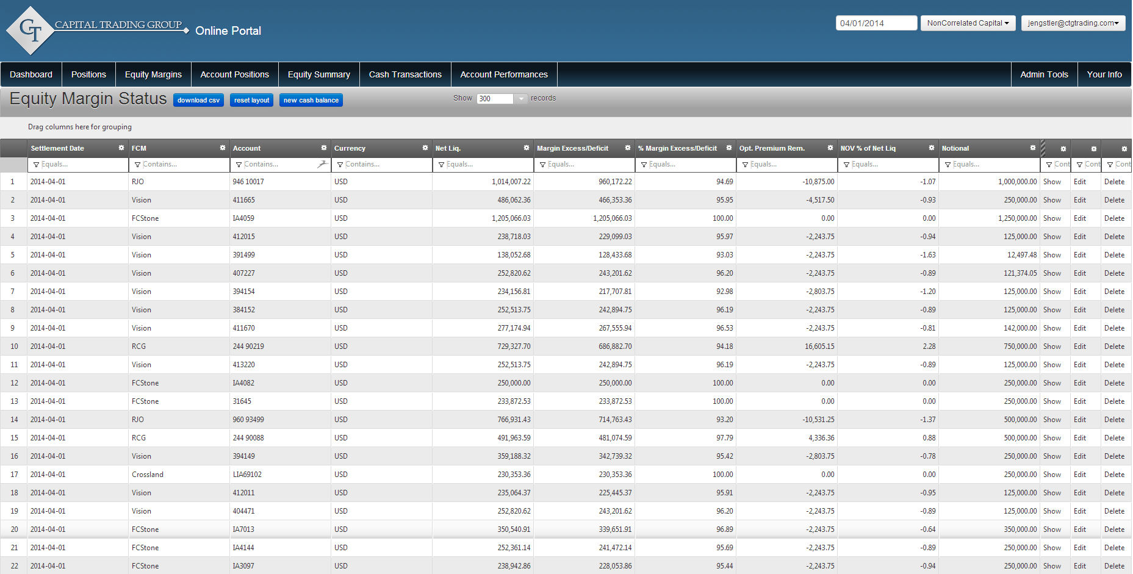
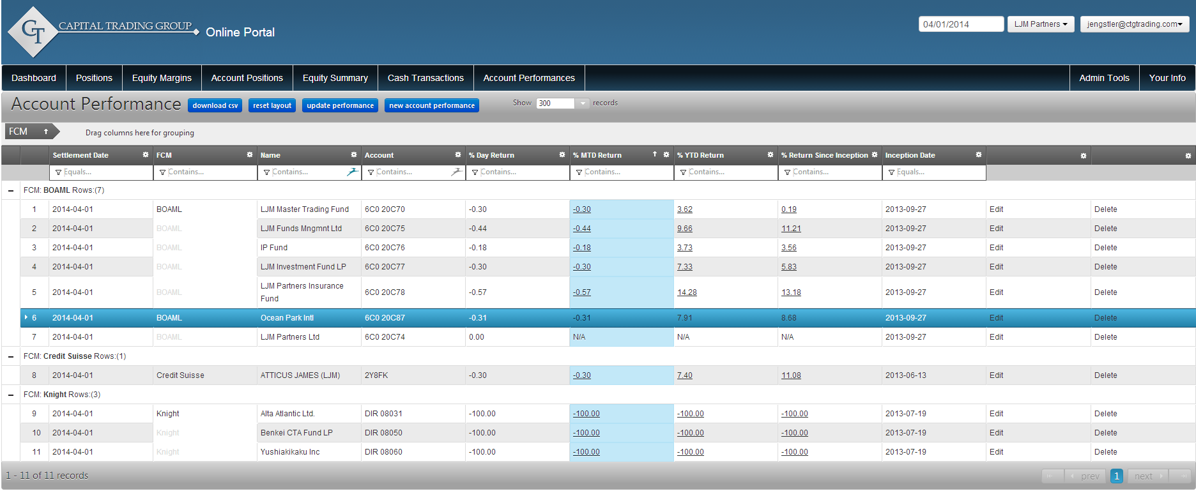
CTA Online Portal© Our one of a kind online access lets you log on from anywhere you have an internet connection to view your program’s positions, account balances, P&L, performance, and more.
Multiple views allow CTA to view Positions and P&L by individual account, commodity, FCM,& market sector.
Net liquidation value and margin balance are broken down for each managed account.
Trading performance is tracked for each account. Daily, MTD, & YTD returns are displayed.

Slide 4
Contact Us
To find out more about what CTG can do to assist your CTA program, as well as customized pricing options, please contact Patrick Lafferty or Nell Sloane directly:
Toll Free (US) 800-554-6290
Direct Tel 312-572-6117
email info@CTGtrading.com
One Financial Place
440 S. LaSalle, Suite 2301
Chicago, IL 60605
www.CTGtrading.com
www.CTGmanagedfutures.com

